Slide 1


Slide 2


Slide 3
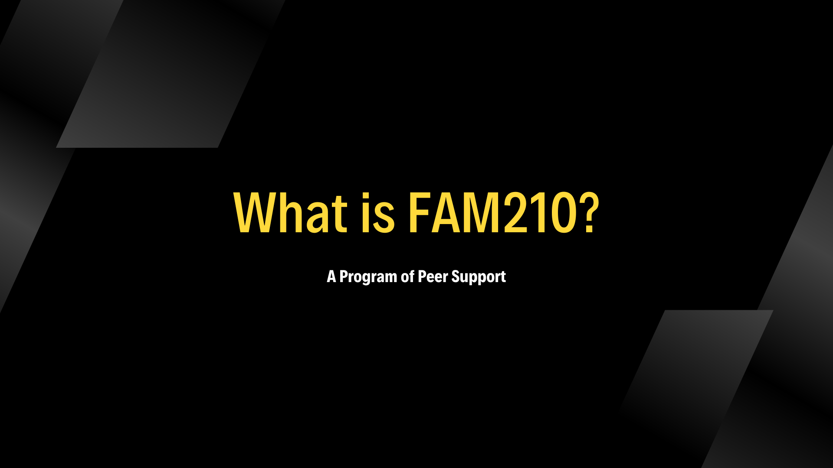

Slide 4
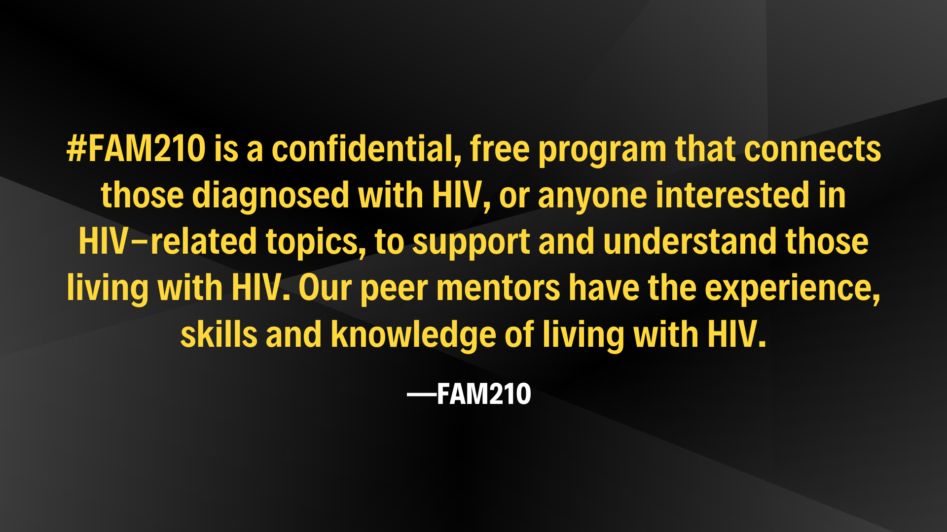

Slide 5
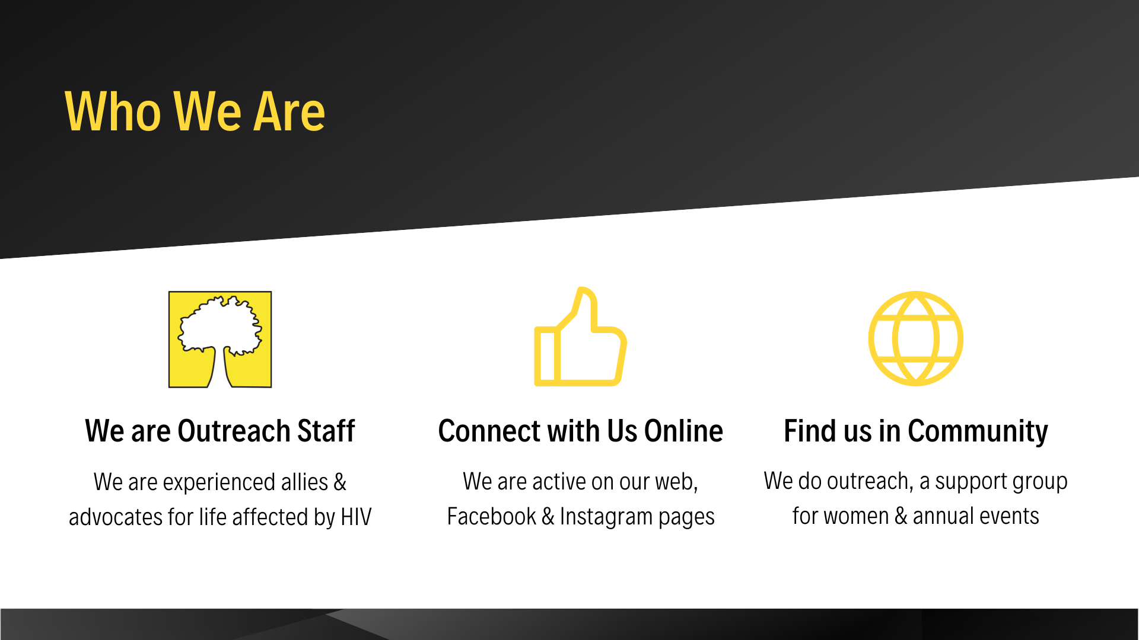

Slide 6
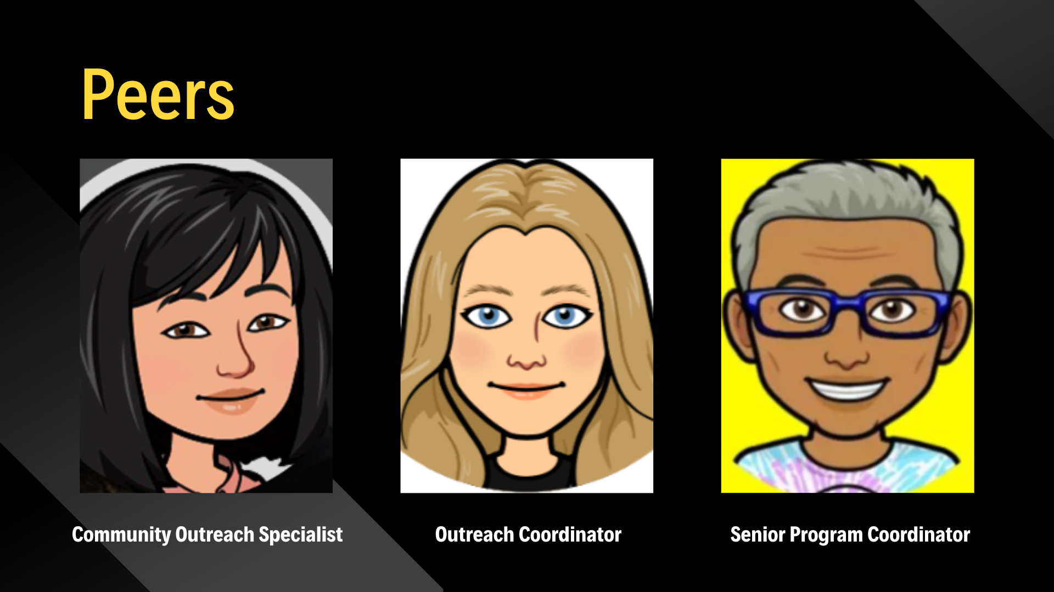

Slide 7
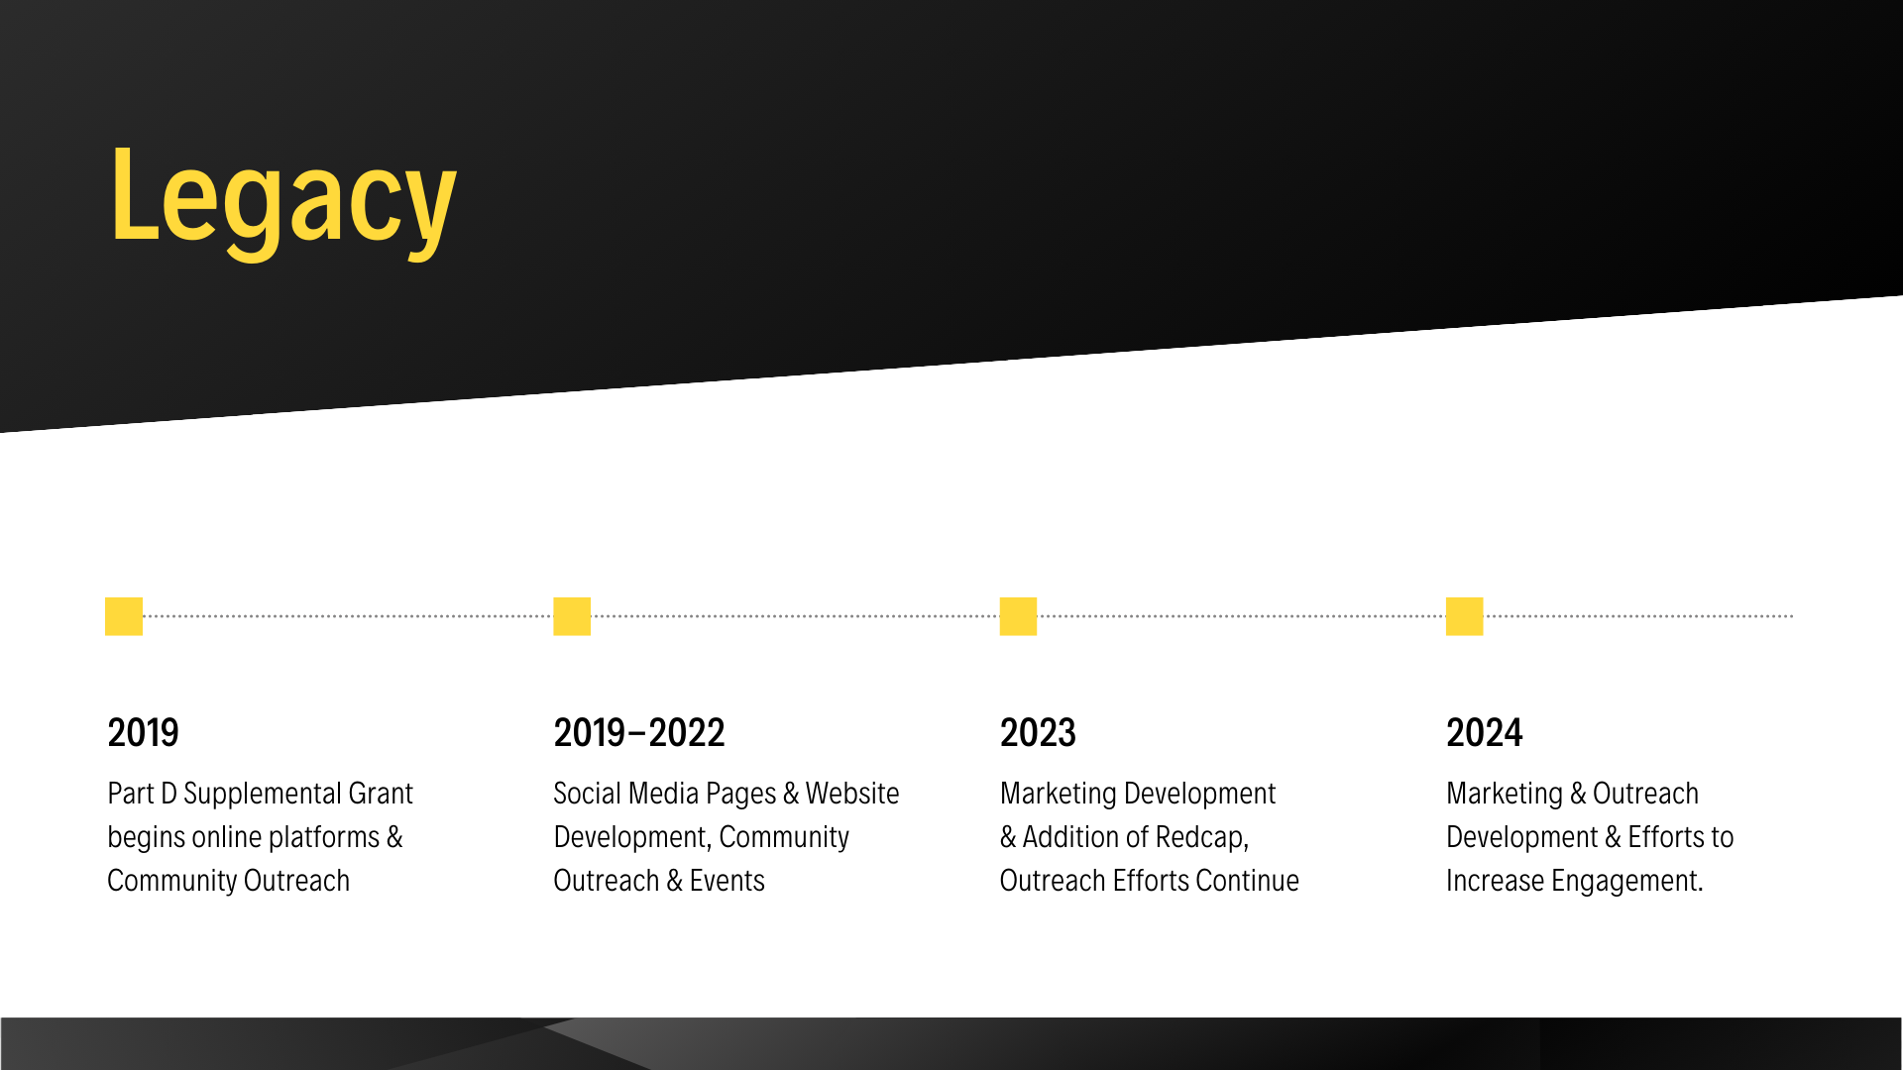

Slide 8
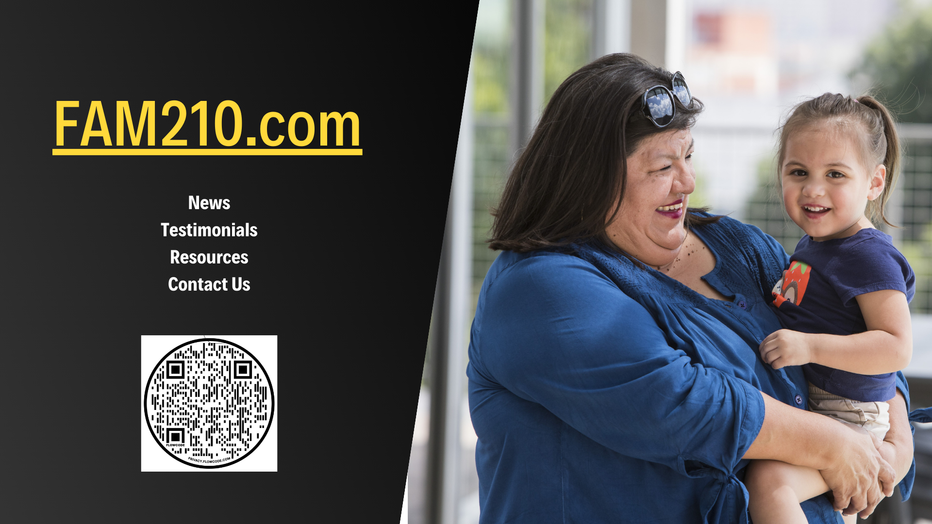

Slide 9
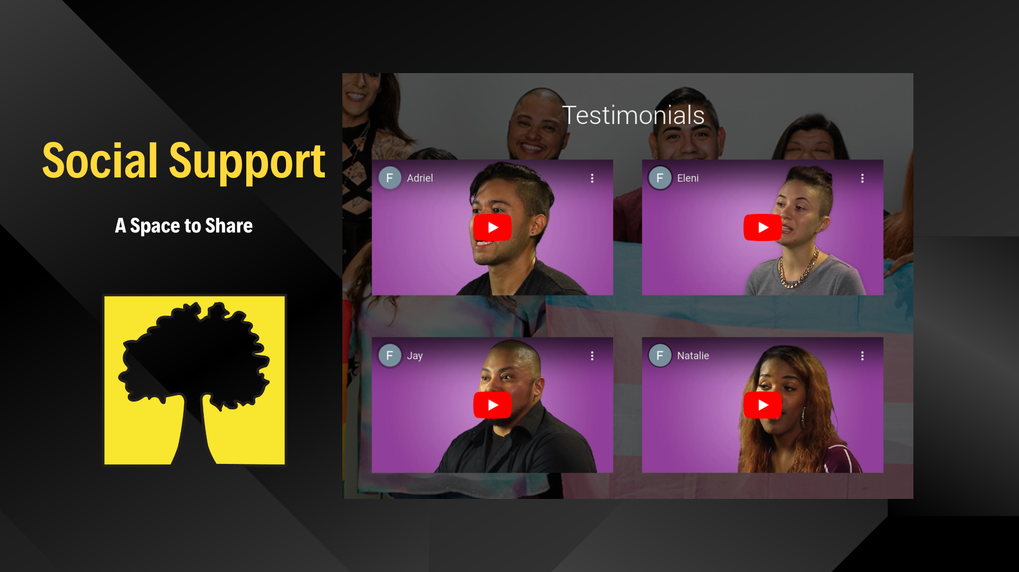

Slide 10
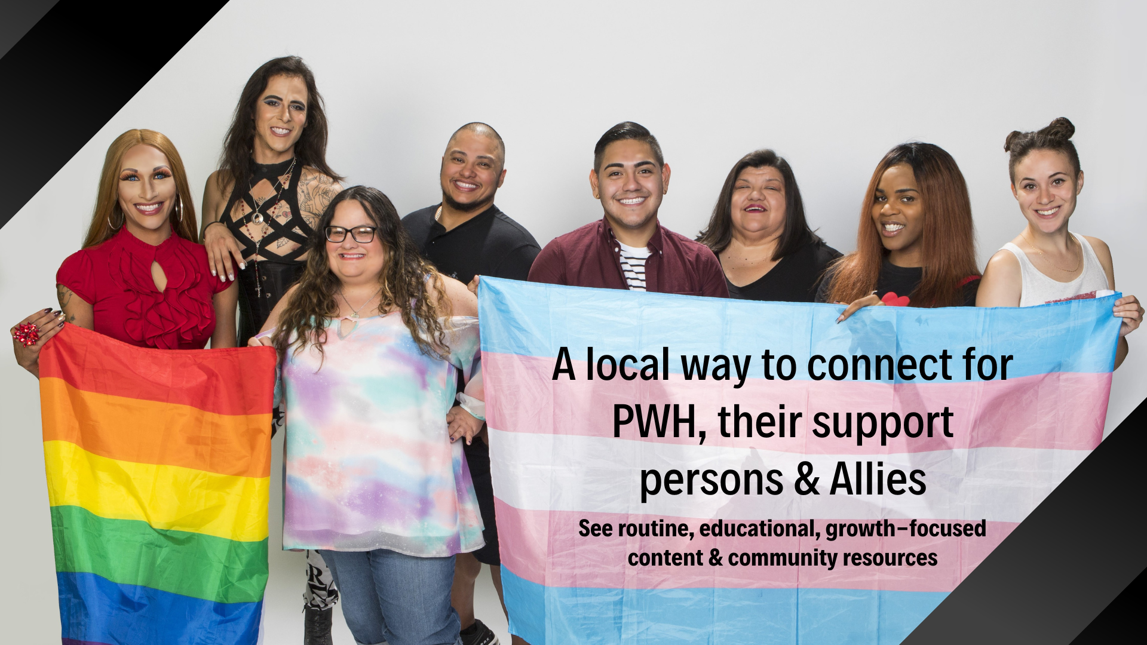

Slide 11
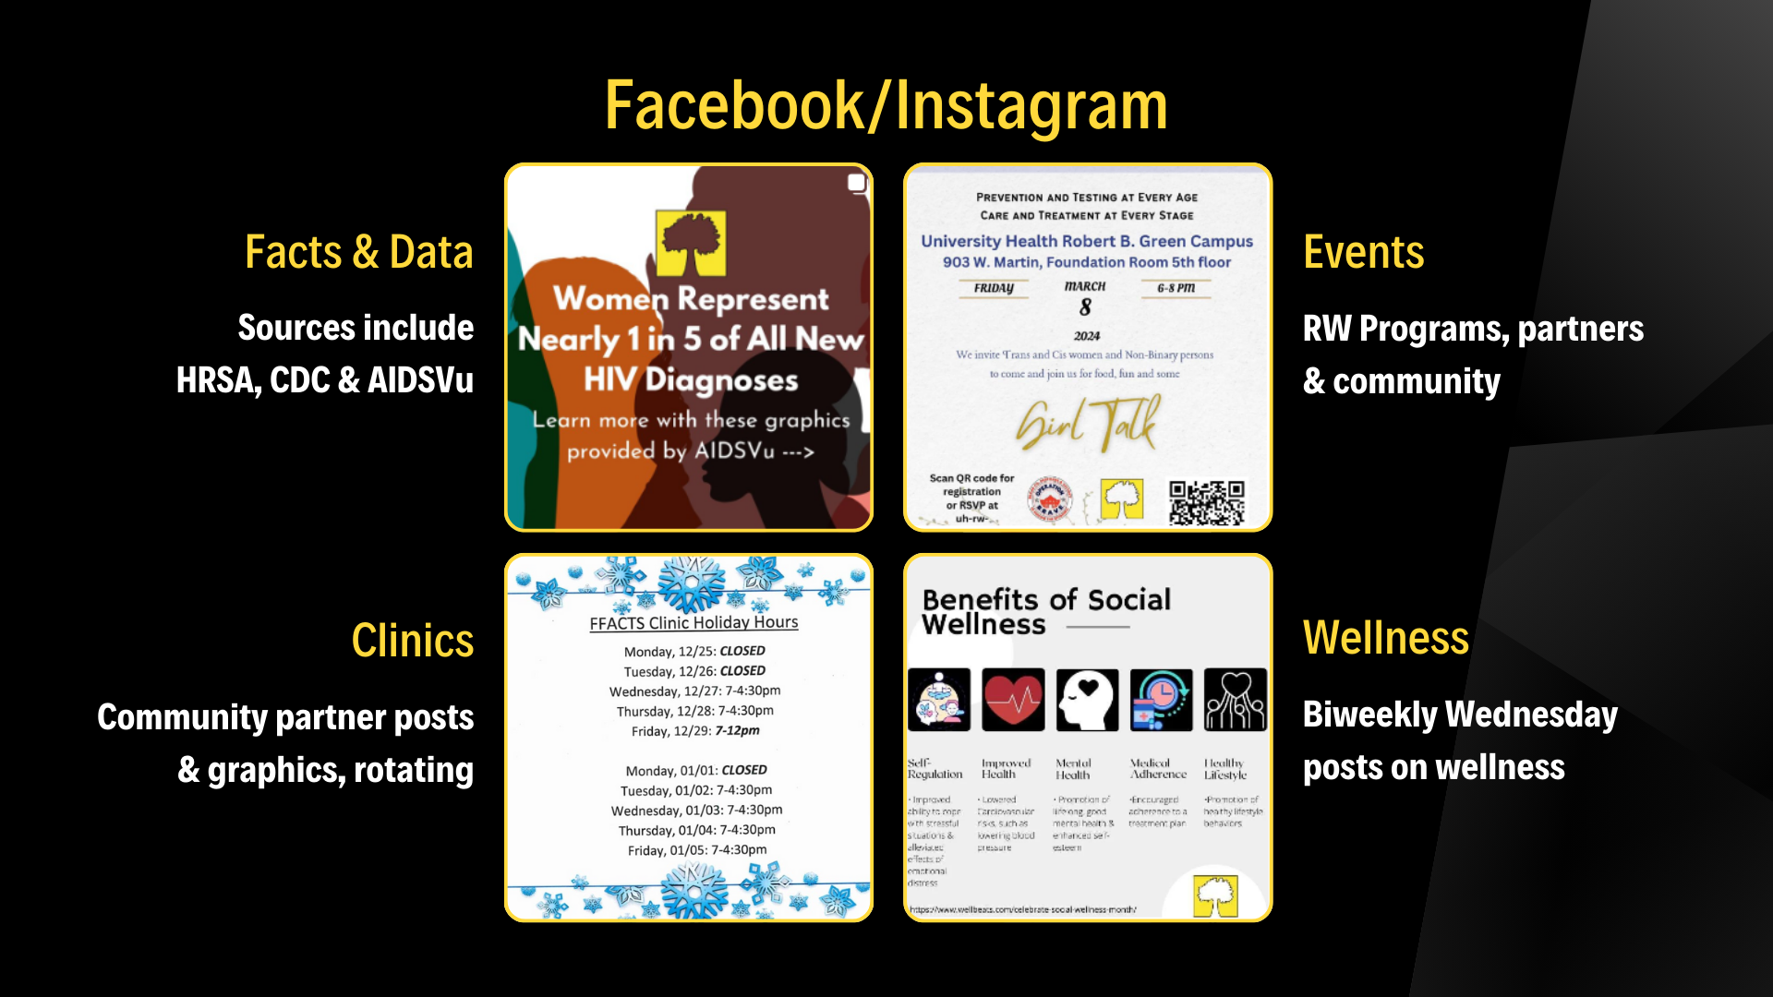

Slide 12
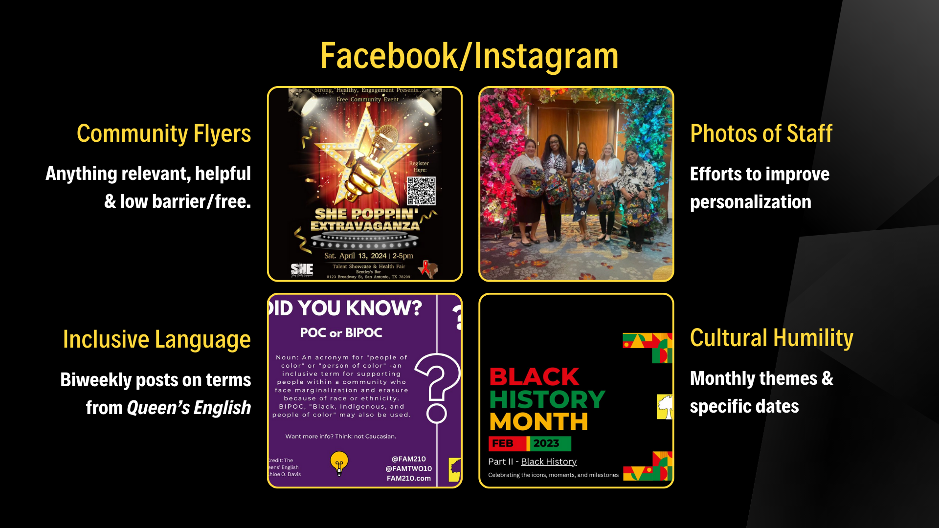

Slide 13
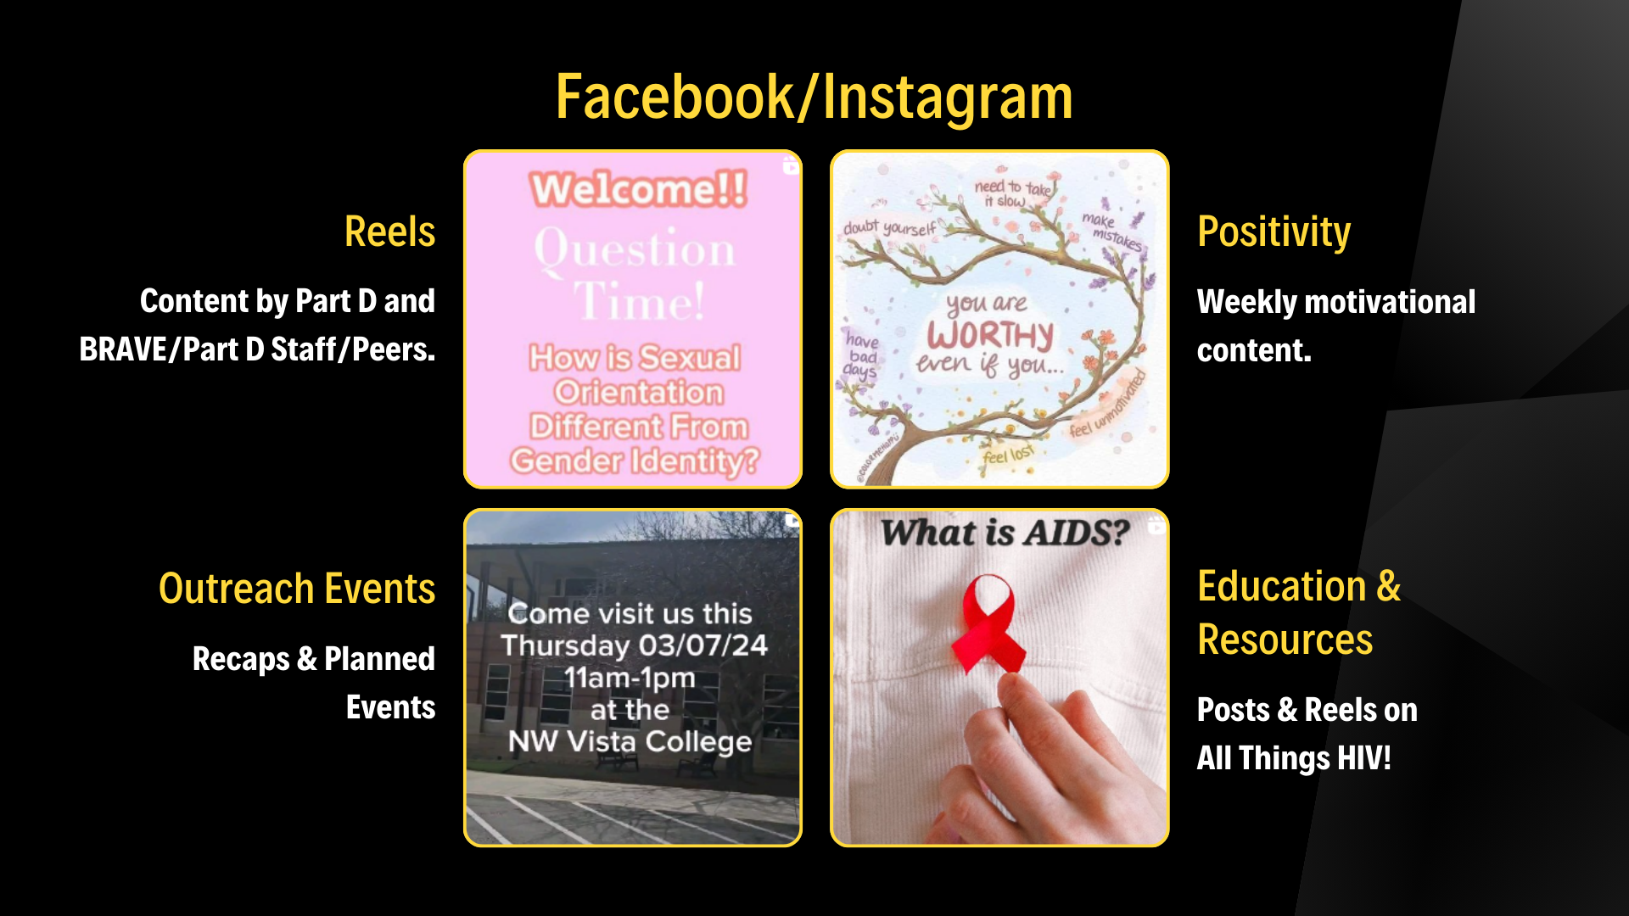

Slide 14


Slide 15
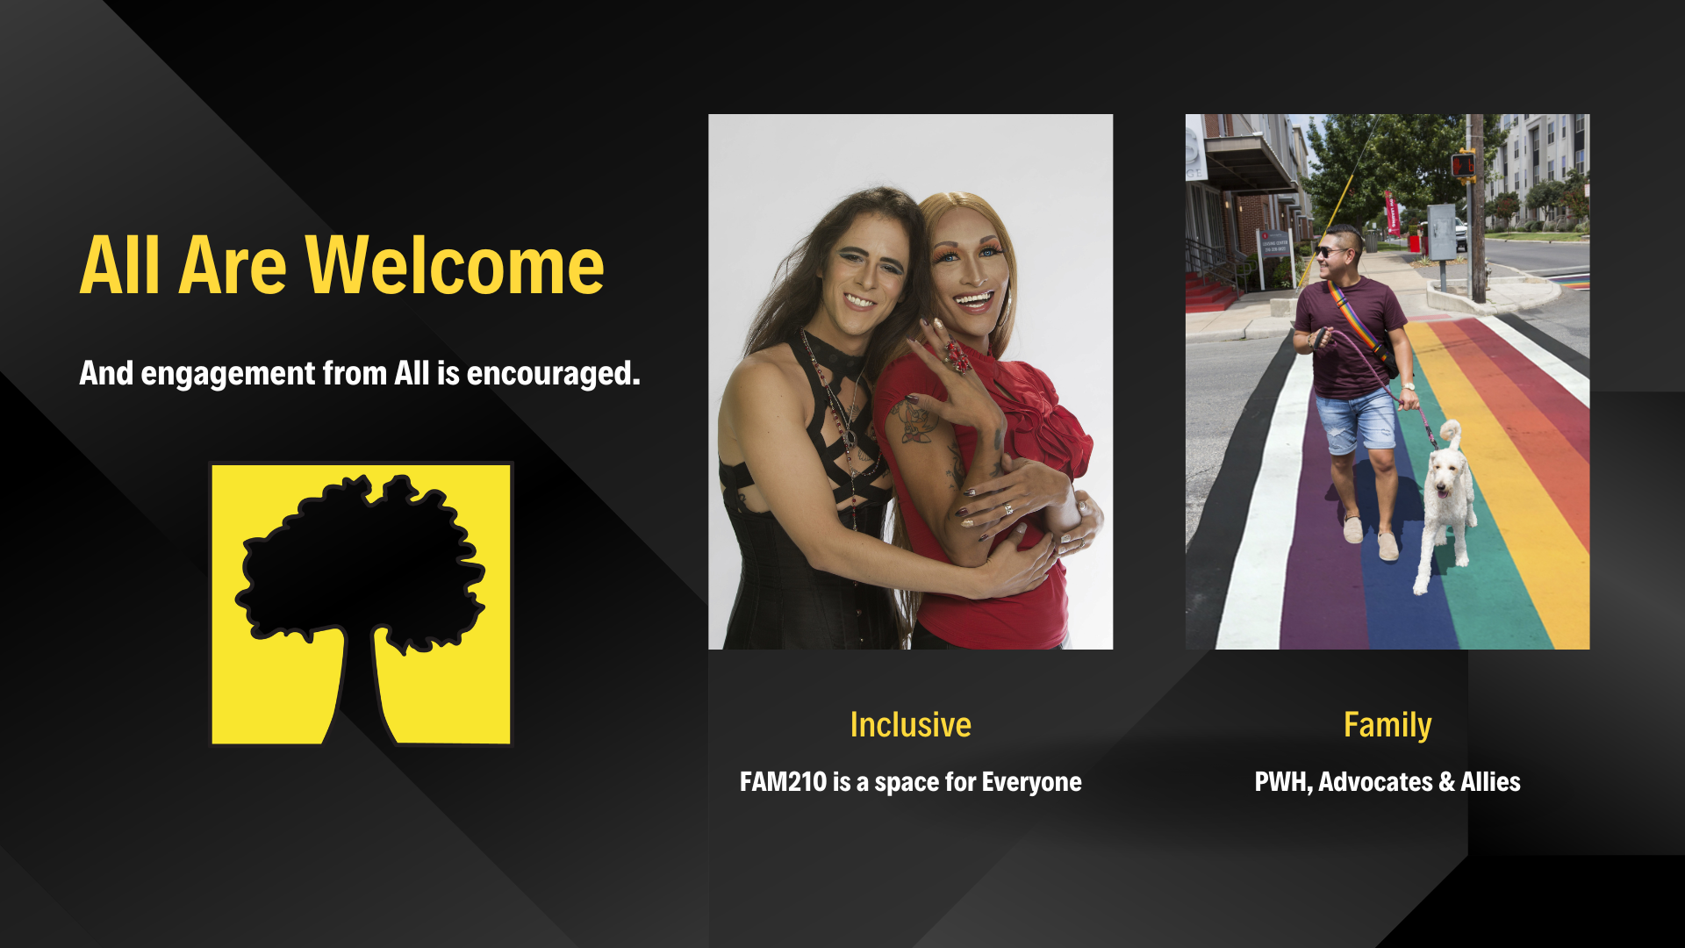

Slide 16
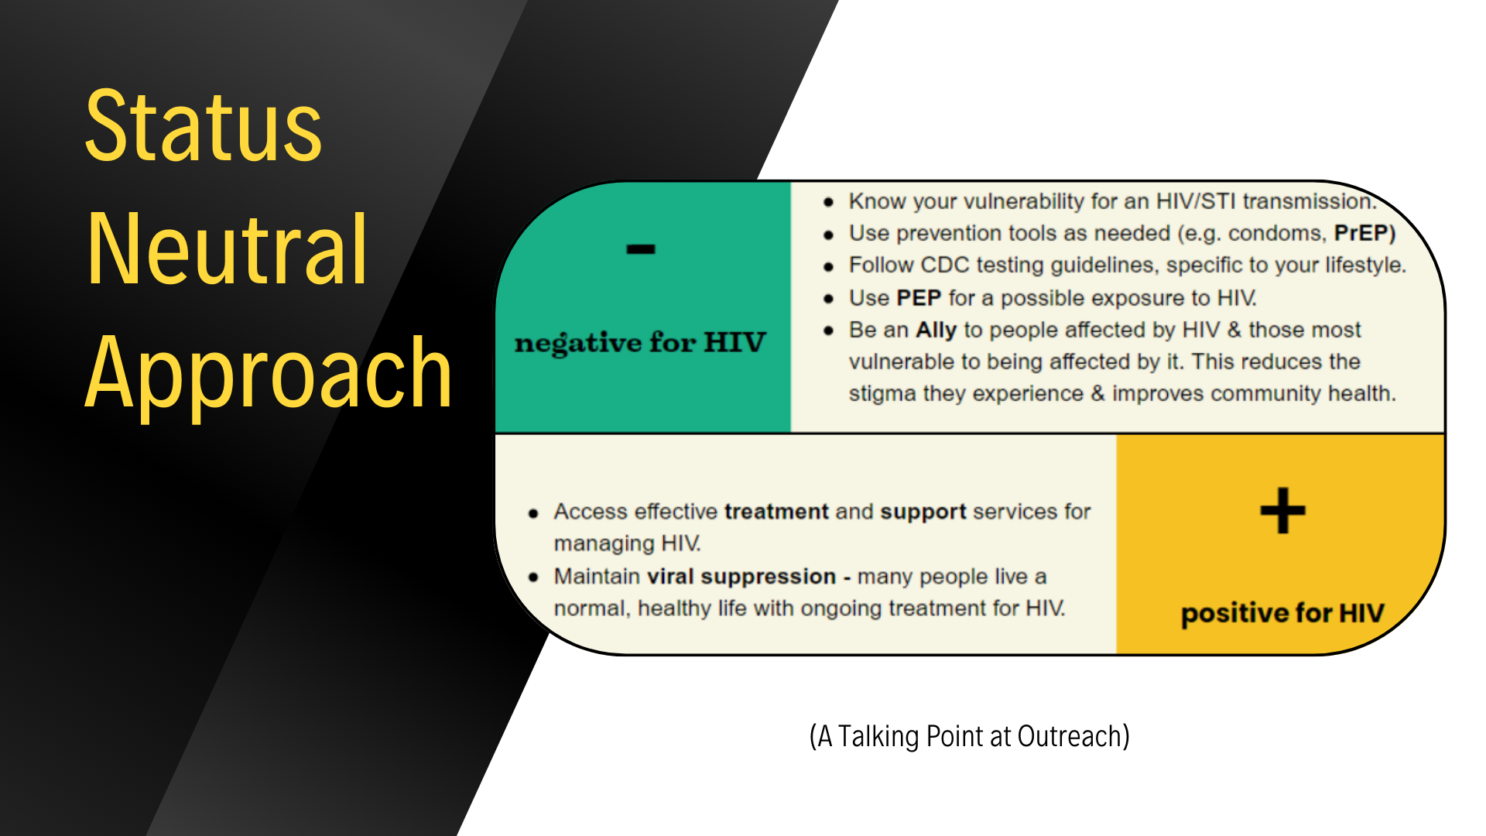

Slide 17
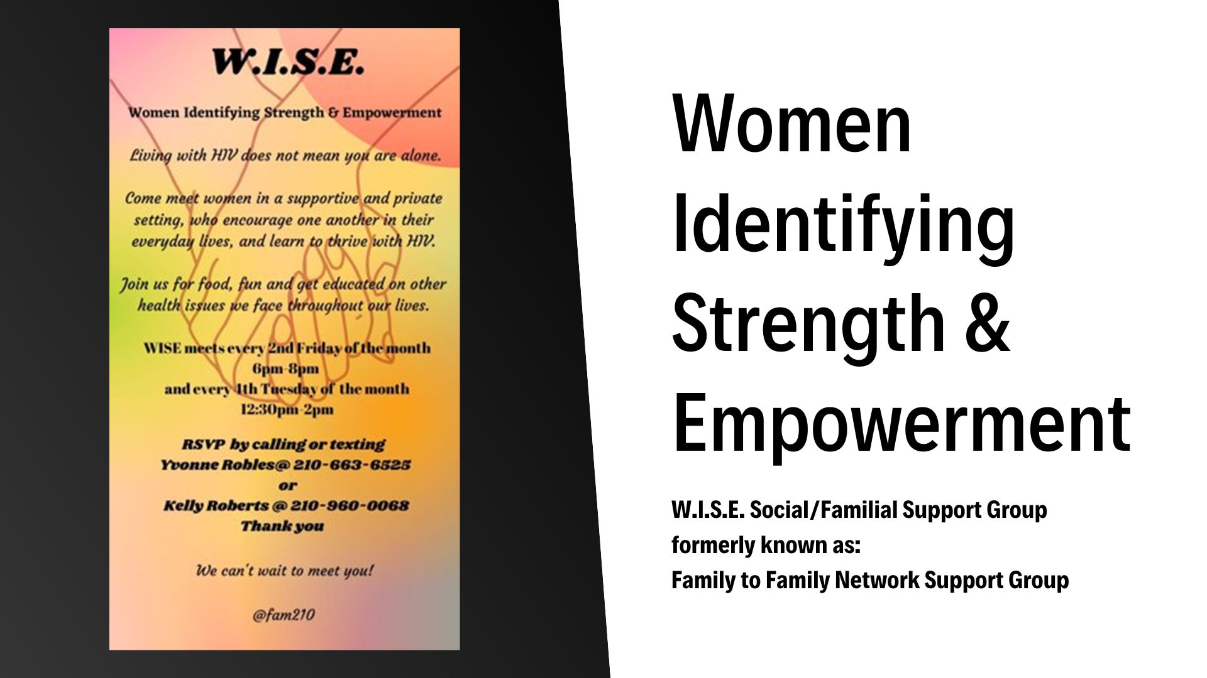

Slide 18





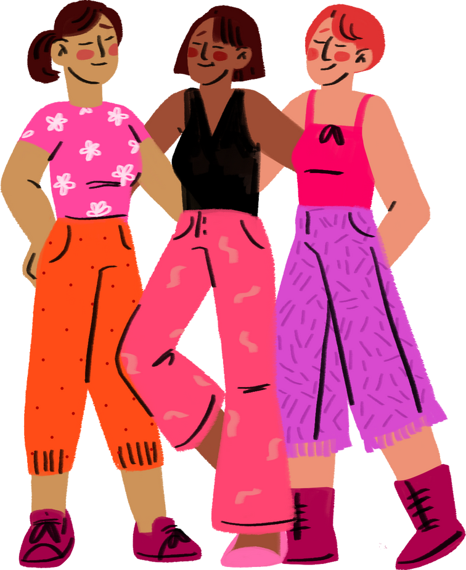




Loving
WISE
Women Identifying
Strength & Empowerment
Beautiful
Women of Worth
Caring

Slide 19

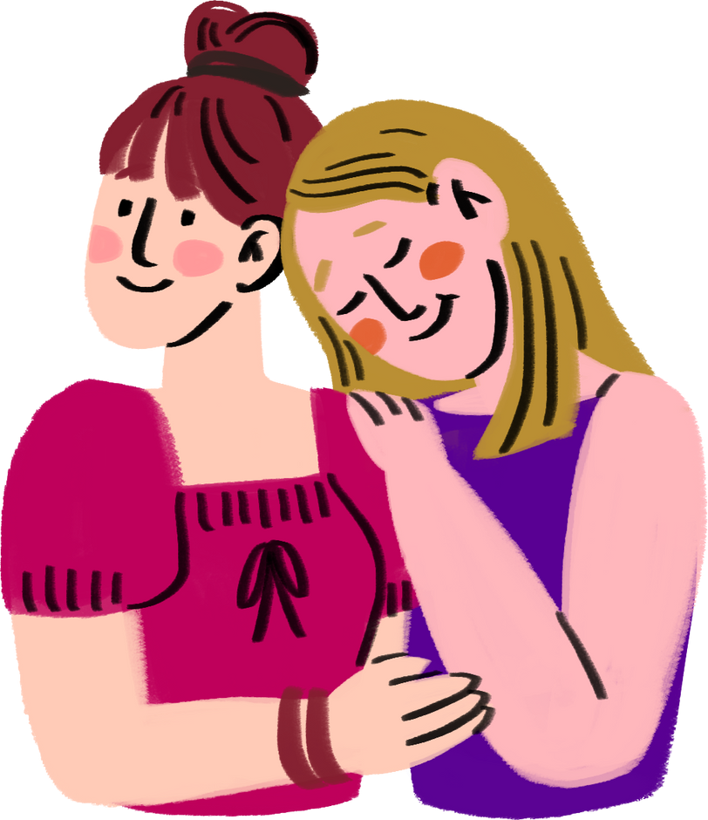
A LITTLE HISTORY
This support group was for Women, Infant, Children, and Youth
  Originated in 1995.
  The name of the group was originally The FFN which stood for Family to Family Network.
  The FFN group would meet at a Pediatrics Clinic on Wurzbach and Babcock Rd.
  The group met @ 7pm every 2nd Monday of the month.
In 2005 the group transitioned to an Episcopal Church downtown and started meeting every 2nd Friday 6-8pm
  After the transition came growth,
  Within 2 years the FFN was serving 26 families.
With a small staff of
  1 Outreach Specialist
  1 Case Manager
  2 Volunteers to help with the children

Slide 20
1 Transition after Another
In July 2011 the group received bad news that both the Outreach Specialist and Case Manager would be leaving. The FFN was not promised, due to not having an Outreach Specialist to facilitate the group.
The following month in August, the FFN group was called in to meet.
  On the day of the meeting there were only 3 women in attendance 2 who were new to the group and 1 who had attended group before.
  In October of that year we finally met our new Outreach Specialist and Mental Health Counselor.
In 2015 the group was transitioned once again.
  This time to the FFACTS Clinic Conference Room.
  Soon after the move 2 more of the women from the old group joined us, and as the time went by more women started joining the group.

Slide 21


FFN to WISE...
A few years later the women asked can we change the name
of the group, there’s nothing but women in the group, there’s no more families.
After a couple of months, with the approval of the name change the women were given 3 names to choose from, and the women chose the name.
W.I.S.E
Women Identifying Strength and Empowerment

Slide 22
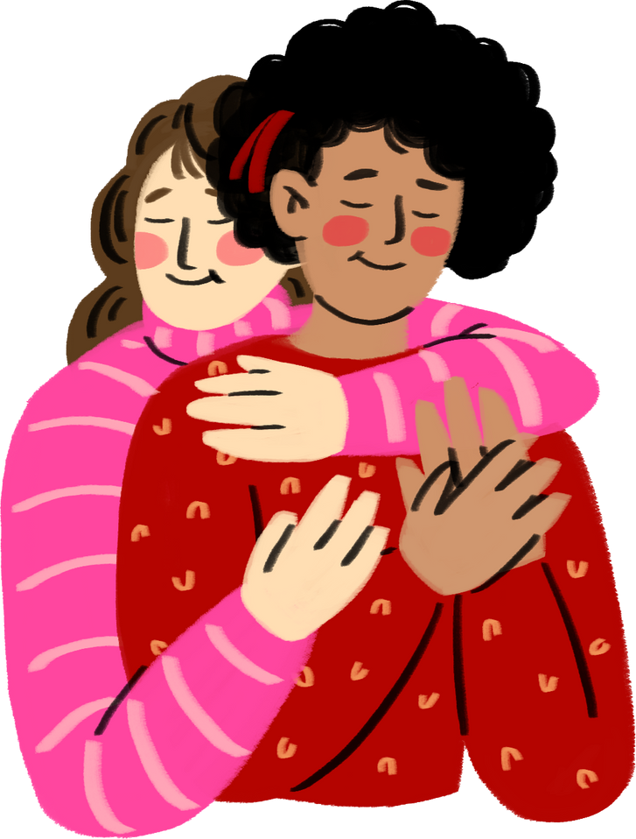
WISE Growth
In 2023 the WISE group starts to grow, this time
with kids and family support, such as mom’s,
husbands and grandbabies too.
  Space to fit the WISE Women.
  Space for the children to play.
  Space to fit the WISE women support.
Soon the group needs space
I am proud to say that the WISE had
  20-22 attendees during the Fall of 2023 from September to December.
  200 attendees in total for the year of 2023.
With hopes to grow the group.

Slide 23
MY FAMILY
BEING A PART OF THIS GROUP IS LIKE HAVING A 2ND FAMILY
  Family that loves and supports you.
  Family that will embrace you with open arms.
  Family that knows and understands your struggles.
  Family that will give you a shoulder to cry on.
  Family that will come together to help you in a time of need.

Slide 24
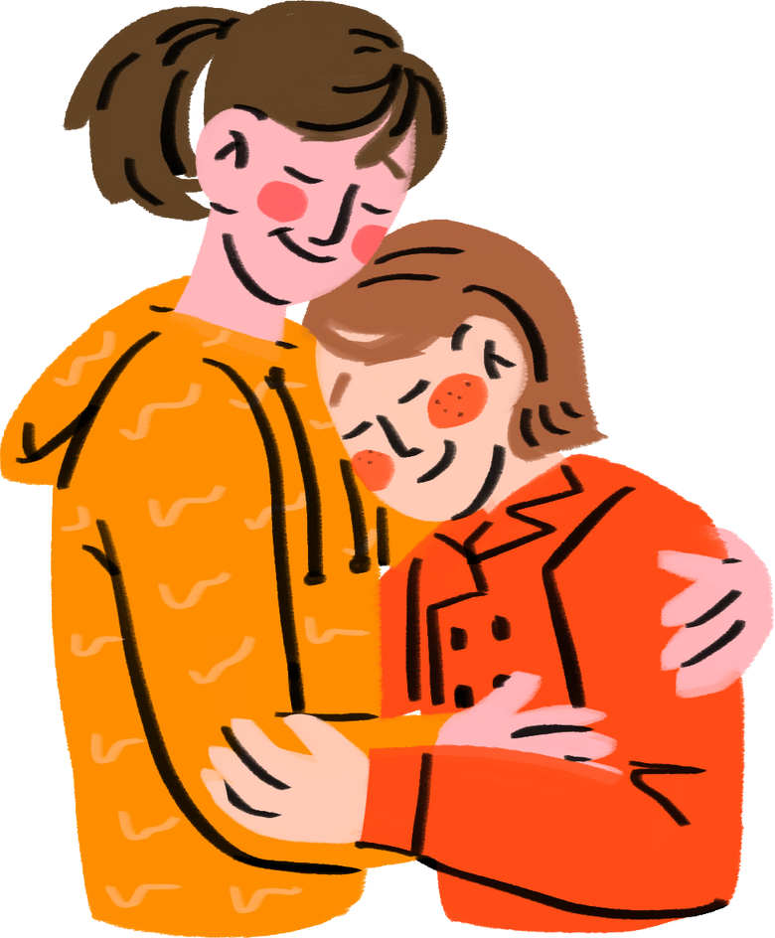
National Women and Girls HIV/ AIDS
Awareness Day
Is an annual event that we plan.
This year’s event was focused on
Prevention and Testing at Every Age.
Care and Treatment at Every Stage.
2 Vendors
  Texas Wears Condoms
  Texas Healthy Women’s Program.
3 Presenters
  Gilead Science-Oscar Perez
  Operation Brave Peer Group
  Social Media influencer-Janeli Alejandra
.

Slide 25





Valentine’s Day
Exchange of Valentine Cards and Candy.
Mother’s Day
Sharing Inspirational words & well wishes.
Happy Mothers Day.
WISE FAMILY
Holiday
Celebrations
Thanksgiving Day
A Day to give Thanks.
Easter Celebration
Plenty of goodie bags and baked goods.
Christmas Celebration
Gift Exchange & Dinner.

Slide 26
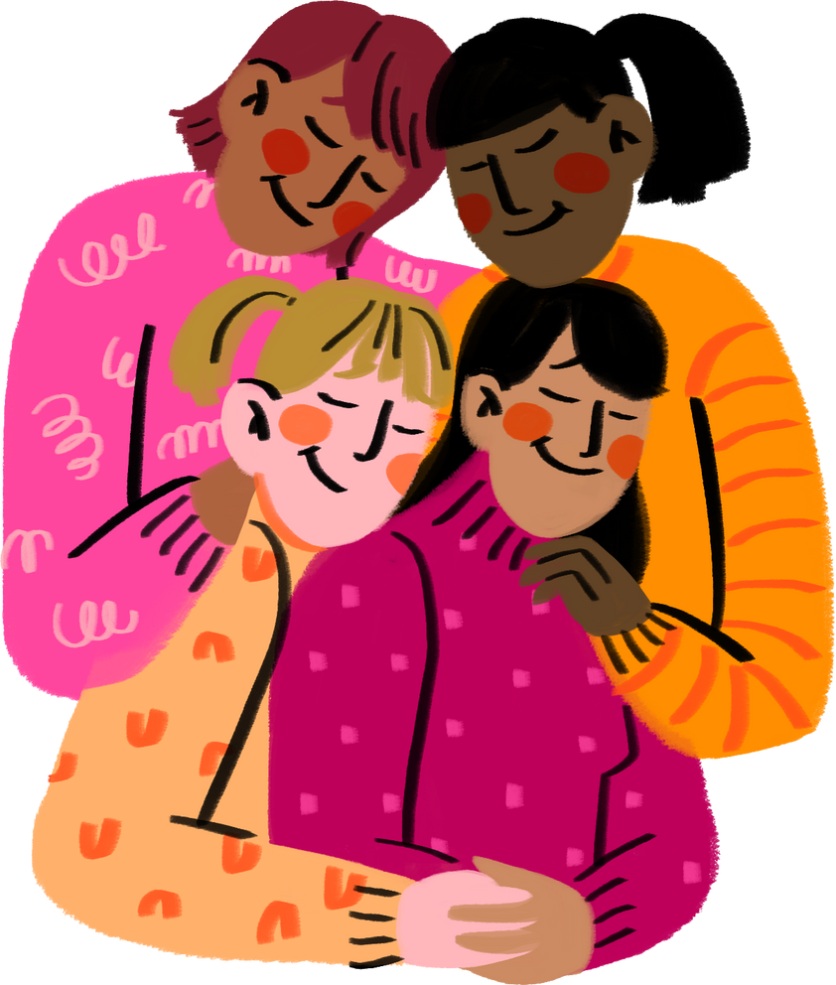
Living with HIV does not mean you are alone.
Come meet women in a supportive and private
setting, that encourage one another in their
everyday lives, and learn to thrive with HIV!
Come join us for food, fun and activities.
Experience a Tea Party
an Ice Cream Social & play Bingo.
Date: Every 2nd Friday of the month
Time: 6:00 PM-8:00PM
Place: Foundation Room 5th floor
@ Robert B. Green Clinic
To RSVP for WISE email me @
Yvonne.Robles@uhtx.com or
Kelly.Roberts@uhtx.com

Slide 27
THANK YOU VERY MUCH

Slide 28


Slide 29
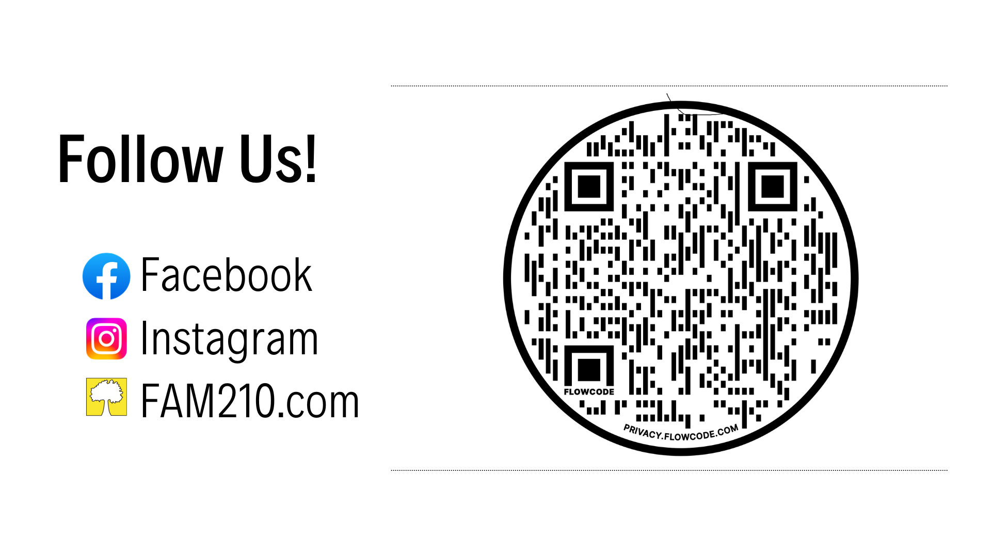

Slide 30
