Slide 1

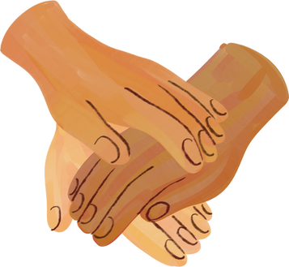





















OPERATION BRAVE

Slide 2
Human Immunodeficiency Virus (HIV)
WHAT IS HIV?
Is a virus that attacks white cells that help your body fight off infections
How do you get HIV?
Is there a cure?
----------------------------------
--------------------------
The most common ways to contract HIV is through:
  Sexual contact
  Injection drug use
  Pregnant women living with HIV can transfer the virus to their baby through birth or breastfeeding
There is no cure for HIV however it is treatable.
With the proper care/medication HIV can be controlled to undetectable levels of virus in your system it can then become untransmittable

Slide 3

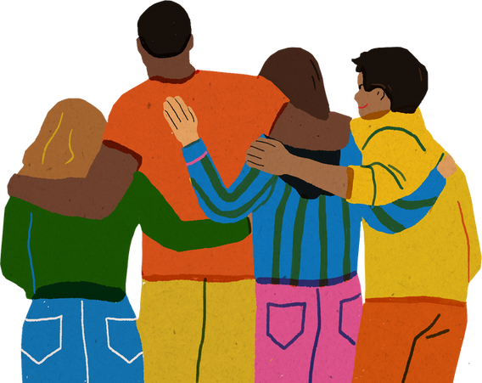
  Founded in 2020 through the U.S Department of Human and Health Services
  We are working toward ending the HIV Epidemic
  Assisting people living HIV positive to get into care or back into care
WHO ARE WE?
Operation BRAVE also known as
Bexar co. Response and Victory in ending the Epidemic

Slide 4

WHAT IS OUR GOAL?
The main goal for Operation BRAVE is ending the HIV Epidemic
We are working toward reducing new HIV infections.
Our goal for the first 5 years (by
2025) is to reduce the number
for new HIV infections by 75%
Our 10 year goal (by 2030) is to
reduce the number for new
infections at least by 90%

Slide 5
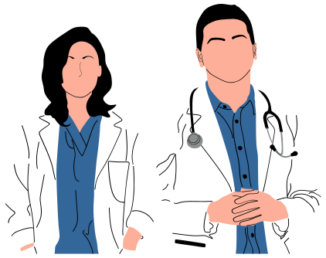
HOW ARE WE HELPING?
We are encouraging people in the community who are living with HIV to recieve care, starting with connecting them to a Nurse Care Coordinator.
Nurse Care Coordinators help with:
Scheduling appointments/appointment reminders
Transportation (monthly bus pass)
Gift cards (grocery store)
Resources (support groups, financial assistance)
This includes Newly diagnosed, Out of Care and Existing patients

Slide 6





GET INVOLVED!
Become a Peer!
Adults ages 18-29 are eligible to be apart of our Peer Program
Work events
Meet new people Educate others
Find new opportunities New source of income

Slide 7

Most importantly..
HELP US END THE HIV EPIDEMIC!

Slide 8




Follow us!
: operationbrave
: @Operation_BRAVE
: Operation BRAVE
or visit our website www.operationbravesa.com

Slide 9

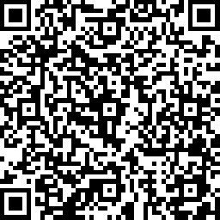
How did we do?
Your feedback is important
Scan the QR to take a quick Survey!

